Slide 1

IBM Cloud Pak for Business Automation
Tech Jam {Americas} – June 28-30, 2022
Tom Al-Hamwy
Program Director, Business Automation SWAT
Swapnil Agrawal
Americas Technical Lead, Business Automation SWAT
We start at 9:10am UTC-4:00h (Eastern Daylight Time)
IBM Software | © 2022 IBM Corporation

Slide 2
Agenda
Who, why and what
Jam Agenda
Logistics
Cloud Pak for Business Automation
Scenario
IBM Software | © 2022 IBM Corporation

Slide 3
Agenda
Who, why and what
Jam Agenda
Logistics
Cloud Pak for Business Automation
Scenario
IBM Software | © 2022 IBM Corporation

Slide 4
Who, Why, What
Who
Why
What
Who are we?
Automation SWAT
World-wide team
Part of product team
Cover all of CP4BA
Who‘s this Jam for?
Foundation audience
Solution implementors
Administrators/DevOps
Learn & enable
Share experiences
Get connected
Hear-out the CP4BA strategy
Experience CP4BA hands-on
IBM Software | © 2022 IBM Corporation

Slide 5
Agenda
Who, why and what
Jam Agenda
Logistics
Cloud Pak for Business Automation
Scenario
IBM Software | © 2022 IBM Corporation

Slide 6
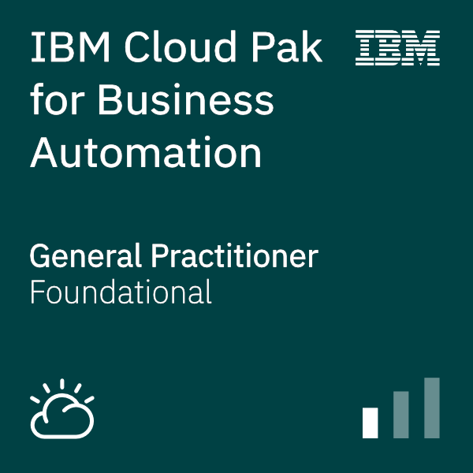
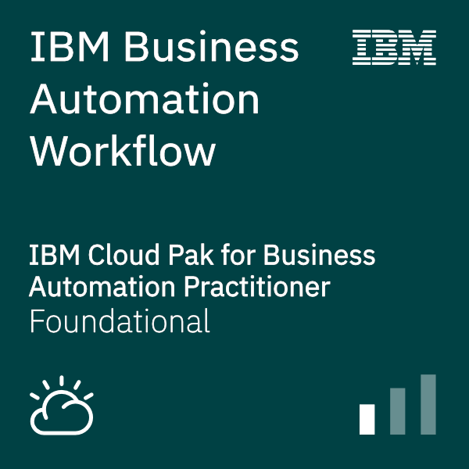
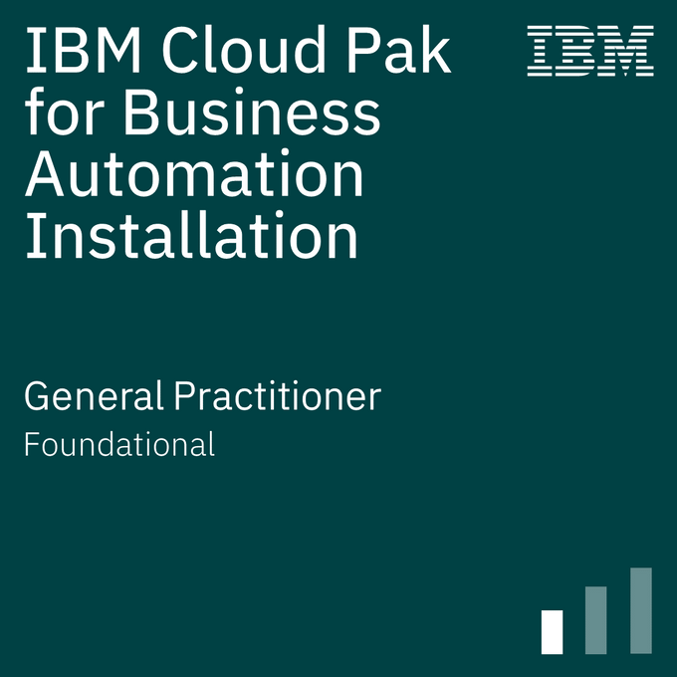
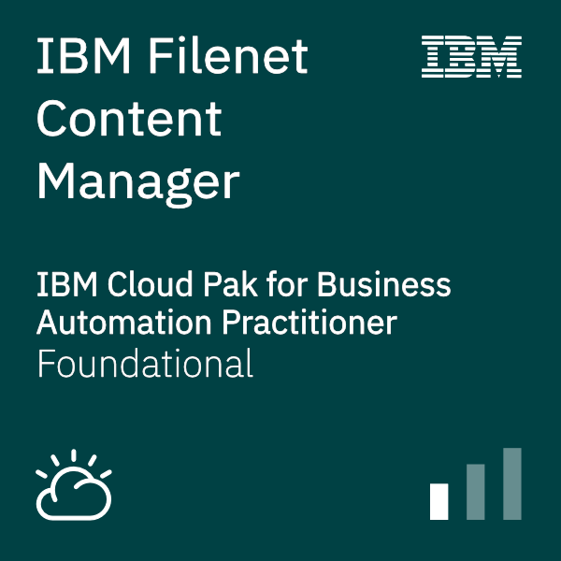
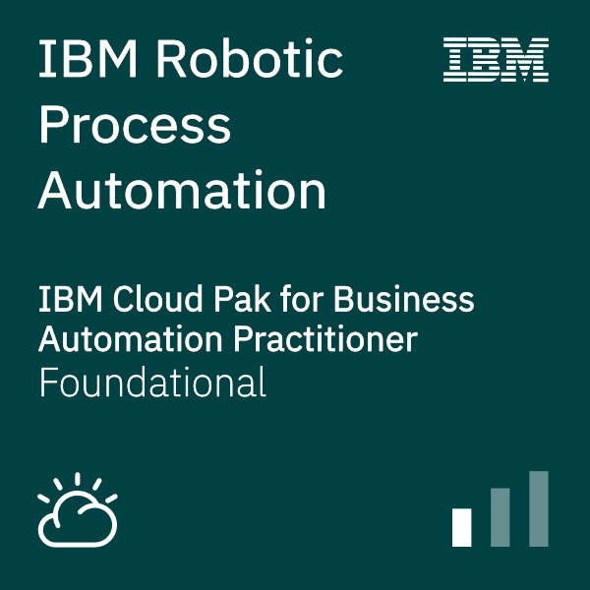
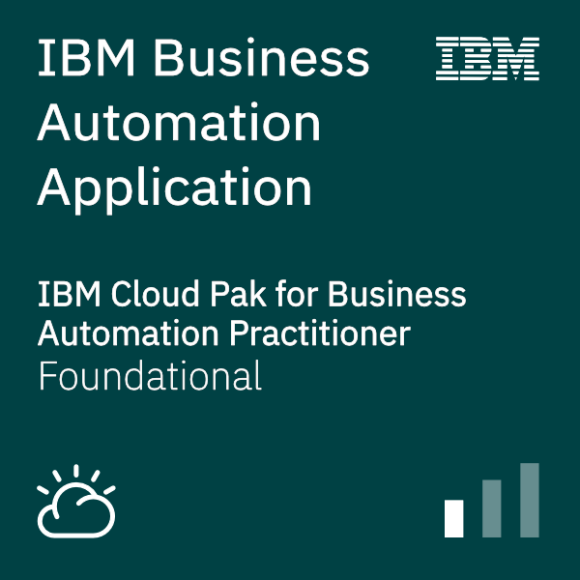
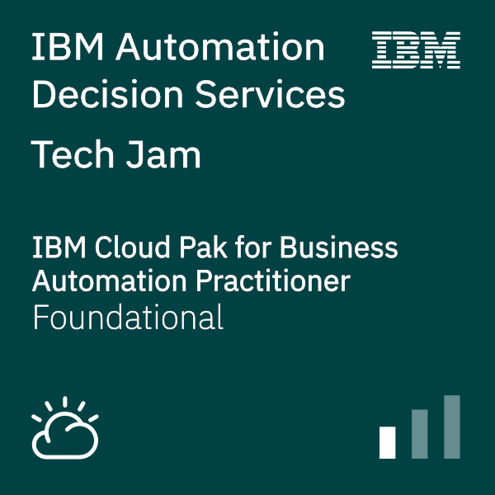
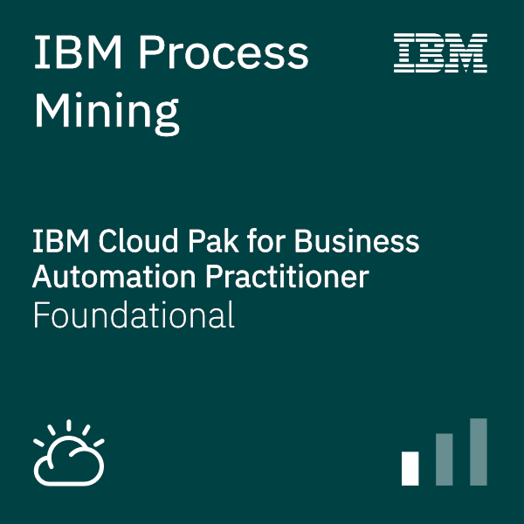
Jam Agenda – {Americas}
Activity – Time Zone GMT-4:00h (Eastern Daylight Time)
WebEx: https://ibm.webex.com/ibm/j.php?MTID=mc7a3ec7fe1d417e2ed15d05368e09275
Day 1
AM
09:00 [All] Arrival & etc.
09:10 [Tom Al-Hamwy] Welcome Note
11:45 [All] Choose & provision scenario
09:30 [Swapnil Agrawal & Jorge Rodriguez] Scenario Overview
PM
13:00 [All] Start scenario implementation
17:00 [Tom Al-Hamwy] Close Day 1
Day 2
AM
09:00 [Tom Al-Hamwy] Day 2 kick-off
09:30 [All] Continue scenario implementation
11:00 [Clandis Baker & Dan Ouimet] Automation Doc. Processing
PM
13:00 [All] Continue scenario implementation
17:00 [Tom Al-Hamwy] Close Day 2
15:00 [Lauren Mayes] Content Services – recent updates and roadmap
Day 3
AM
09:00 [Tom Al-Hamwy] Day 3 kick-off
10:30 [All] Complete scenario implementation
09:30 [Owen Cline] Workflow Process Service (WfPS)
PM
Survey: https://www.surveymonkey.com/r/CP4BATechJam2022
15:00 [Tom Al-Hamwy] Feedback / Open Discussion / Q&A & Closure
IBM Software | © 2022 IBM Corporation

Slide 7
Agenda
Who, why and what
Jam Agenda
Logistics
Cloud Pak for Business Automation
Scenario
IBM Software | © 2022 IBM Corporation

Slide 8
Logistics – {Americas}
Dates
Americas [GMT-4:00h]: Tuesday June 28th to Thursday 30th [9:00am – 5:30pm]
Logistics
Participants
Technical Team
Hosts:
Americas: Tom Al-Hamwy, Swapnil Agrawal
Participants: 103
Registrants: 127
Americas
Business Partners 12
IBMers 91
CSM[40] | EL[25] | TS[16] | CE[4] | Other[13]
Alain Robert (ADS)
Clandis Baker (Capture)
Jorge Rodriguez (CP4BA, Infrastructure)
Paul Pacholski (BAW, RPA, BAI, Process Mining)
Sundeep Anne (CP4BA, Infrastructure)
Swapnil Agrawal (CP4BA, BAA, BAW, BAI)
WebEx:
Americas: https://ibm.webex.com/ibm/j.php?MTID=mc7a3ec7fe1d417e2ed15d05368e09275
Countries Represented: [6]
Canada, Chile, Colombia, Ecuador, Mexico, Peru, USA
Instructions:
Bring your own laptop
(optional) Tablet / secondary screen
Communication - Slack:
One #cp4ba-tech-jam-main-lobby and several per topic channels #cp4ba-tech-jam-XXXX created
If this is your first time accessing IBM Slack workspace you should have received an email from Slack titled: Tom Al-Hamwy has invited you to join a Slack workspace
Follow the instructions in the email to register & gain access to the slack channels
Material - GitHub
One stop for all material accessible across IBM
https://github.com/IBM/cp4ba-tech-jam
IBM Software | © 2022 IBM Corporation

Slide 9
Agenda
Who, why and what
Jam Agenda
Logistics
Cloud Pak for Business Automation
Scenario
IBM Software | © 2022 IBM Corporation

Slide 10




The IBM hybrid cloud software approach
Deliver software for specific use cases or personas in Cloud Paks or cloud standalone
Solutions, products and applications
Watson
Infuse AI for business throughout
our software
Unify and simplify software experiences with seamless integration of related capabilities
Cloud Paks
Enable software to run anywhere, on any cloud, as agile cloud-native services
Hybrid cloud platform
IBM Software | © 2022 IBM Corporation
Notes:
IBM has created a highly innovative and unique approach to delivering software optimized for requirements of a hybrid cloud and AI world. Our hybrid cloud software has been totally renovated, through a combination of (1) building new cloud-native software, (2) modernizing our traditional capabilities for cloud-native and (3) creating a common set of foundational platform services that enable modularity, customization, plug-n-play and ease of deployment, integration and management.
It’s a totally new portfolio - with a totally new set of benefits - that many of our clients are not yet aware of and our competitors are surely to replicate, in time.
IBM’s hybrid cloud software can now run anywhere, on any cloud, and integrate everywhere through an open and extensible set of software capabilities.
The software architecture starts with a common set of hybrid cloud platform services anchored on the open source innovation of Red Hat OpenShift. This provides our clients that ability to run our software anywhere, on any cloud, on an enterprise-grade cloud-native platform. All IBM software will evolve to support this foundational hybrid cloud platform.
On the Red Hat Hybrid Cloud Platform, IBM delivers a set of 6 IBM Cloud Paks which each deliver a set of unified, domain-specific software capabilities within one seamlessly integrated experience. IBM Cloud Paks are available for Data, Applications, Integration, security, automation and multicloud management. Importantly, Cloud Pak for easily extended with additional capabilities from IBM and an open ecosystem of business partners and open source communities delivering endless customization to unique client needs. Cloud Paks offer an unprecedented degree of simplification and integration, and the flexibility to run anywhere.
In addition to the software capabilities available re-integrated in Cloud Paks, IBM is delivering an array of additional software products and AI application that are more use case or persona based, such as for planning analytics, AIOps, Regtech, Databases, DevOps, threat analytics, etc.. These software capabilities can be used stand-alone or integrated into IBM Cloud Paks as part of its unified experience.
Our hybrid cloud architecture is built to create generational leap in value for our clients, by being built to simplify, consume anywhere and speed modernize of existing capabilities.
Let me tell you more about this.

Slide 11



IBM Automation platform The most complete set of business and IT Automation services, powered by AI
Use cases
Customer experience
App and infrastructure stability
Hybrid cloud integration
Site deployment automation
Business operations
Platform operations
Real-time analytics
4G/5G telco cloud platform
Workforce management
Optimize AIOps
Transactional integrity
NFV lifecycle management
IBM Cloud Paks
IBM Cloud Pak for Business Automation
IBM Cloud Pak for Watson AIOps
IBM Cloud Pak for Integration
IBM Cloud Pak for Network Automation
Workflow and decisions
Content services
Operational intelligence
Application impact avoidance
Hybrid application management
Observability
Application integration
API management
Messaging and events
Intent-driven orchestration
Closed-loop operations
Network optimization
Automation foundation
Robotic Process Automation
Process and task mining
Natural language interactions
Machine learning
Event detection
3rd Party integrations
Operational models
IBM Cloud
AWS
Microsoft Azure
Google Cloud
VMware
Private
IBM Z IBM LinuxOne IBM Power Systems
End points
IBM Software | © 2022 IBM Corporation

Slide 12









IBM Cloud Pak for Business Automation
AI-Powered/Intelligent Automation
Low-code applications
Automation
accelerators
Process mining and modeling
RPA and digital labor
Operational intelligence
Core automation
Document processing
Workflow
Decision management
Content services
AI and machine learning
Automation foundation
Robotic Process Automation
Process and task mining
Natural language interactions
Machine learning
Event detection
3rd Party integrations
Operational models
IBM Cloud
AWS
Microsoft Azure
Google Cloud
VMware
Private
IBM Z IBM LinuxOne IBM Power Systems
End points
IBM Software | © 2022 IBM Corporation

Slide 13
IBM Cloud Pak for Integration
Client and partner applications
Shared asset
repository
Unified governance framework
API management
Application integration
End-to-end security
Enterprise messaging
Event streaming
High speed data transfer
AI and machine learning
Automation foundation
Robotic Process Automation
Process and task mining
Natural language interactions
Machine learning
Event detection
3rd Party integrations
Operational models
IBM Cloud
AWS
Microsoft Azure
Google Cloud
VMware
Private
IBM Z IBM LinuxOne IBM Power Systems
End points
IBM Software | © 2022 IBM Corporation
Notes:
- Cloud Pak for Integration is built on IBM's Automation foundation
- As such, you'll see increasing amounts of automations across the integration lifecycle in 2021
- Under the covers, we take advantage of RPA, Process mining, event detection and Machine learning. We're expanding the use of natural language interactions with IBM software. And we bake in operational model best-practices out of the box. You'll also find 3rd party integrations, for instance if you'd like to use a different ML engine (vs. the default Kubeflow)
- Cloud Pak for Integration is built on and optimized for RH OpenShift for an open and flexible choice to deploy on virtually any cloud for system needed to put your integrations next to the back-end systems being integrated with
- Cloud Pak for Integration provides a unified experience for multi-style integrations with a shared asset repository while ensuring governance around your integrations
- And you can deploy integration components across clouds but manage from a single location for ease of operations
- [PROMPTING QUESTION]: Which clouds are your back ends distributed across?
- [PROMPTING QUESTION]: When other vendors talked to you about multi-cloud did the explain whether each cloud you deploy their integration offering onto will require a separate management environment? (Cloud Pak for Integration provides central management for components deployed across clouds, unlike competition)

Slide 14
Agenda
Who, why and what
Jam Agenda
Logistics
Cloud Pak for Business Automation
Scenario
IBM Software | © 2022 IBM Corporation

Slide 15



Intelligent Client Onboarding Scenario – Introduction IBM Automation platform
Focus Corp is a service provider across various industries such a Finance, Healthcare and more
The Client Onboarding use case utilizes multiple business automation capabilities in the IBM Cloud Pak for Business Automation to digitize business operations
Features
AI-powered intelligent automation
Straight-through processing and knowledge worker review
Usage of low-code apps, RPA, workflow, decisions and content
Assets are used for enablement (Tech Jams), POCs, testing, sales and customer demos
Focus Corp
IBM Software | © 2022 IBM Corporation
Notes:
Client onboarding solution without CP4BA would require excel sheets, back and forth emails, isolated systems

Slide 16

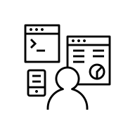




Intelligent Client Onboarding Scenario Flow IBM Automation Platform
Intelligent Automation
Business Automation
Integration
Fill out onboarding info
Page 1
Review documentation
Page 2
Submit
for approval
Page 3
Business Automation Application
Manual intervention if required
Workflow
App Connect
Workflow
Decisions
Content
Orchestrate tasks
based on info provided
Send Email via Gmail
Retrieve details based on client name
Determine services fee and additional services to offer
Review existing
client documents
Capture
Decisions
RPA
Workflow
Collect additional documents and validate ID
Scoreboarding
(Assess risk and classify client)
Add client to legacy system
Provide approval status notification
IBM Software | © 2022 IBM Corporation

Slide 17
Intelligent Client Onboarding Scenario Flow IBM Automation Platform
Intelligent Automation
Business Automation
Integration
Fill out onboarding info
Page 1
Review documentation
Page 2
Submit
for approval
Page 3
Business Automation Application
Manual intervention if required
Workflow
App Connect
Workflow
Decisions
Content
Orchestrate tasks
based on info provided
Send Email via Gmail
Retrieve details based on client name
Determine services fee and additional services to offer
Review existing
client documents
Capture
Decisions
RPA
Workflow
Collect additional documents and validate ID
Scoreboarding
(Assess risk and classify client)
Add client to legacy system
Provide approval status notification
IBM Software | © 2022 IBM Corporation

Slide 18
Demo
IBM Software | © 2022 IBM Corporation

Slide 19
Intelligent Client Onboarding Scenario – Summary IBM Automation Platform
Client Onboarding solution showcases a combination of capabilities from the IBM Automation platform
The end-to-end solution digitizes all aspects of the business freeing up knowledge workers
Highlights how using AI for automation can improve efficiency without losing control
Scenario will be expanded to include additional capabilities
IBM Cloud Paks can further add value:
Cloud Pak for Data to add more AI capabilities
Cloud Pak for AIOps & Security to operate and secure the solution
Focus Corp
IBM Software | © 2022 IBM Corporation

Slide 20
Tracks
Different tracks to cater for different target groups and previous levels of exposure to Cloud Pack for Business Automation
Track 1 – Foundation
Audience: New to Cloud Pak for Business Automation (CP4BA)
Learning: Overview of the Cloud Pak from an end-user perspective
Approach: Perform the Client Onboarding scenario
Track 2 – Developer Role / Solution Implementation
Audience: Base understanding of Cloud Pak for Business Automation (CP4BA)
Learning: Overview of the Cloud Pak from developer and partly user perspective
Ability to develop pieces of the solution areas
Approach: Detailed lab instructions to build respective solution aspects
Track 3 – Administrator Role (restricted number of participants)
Audience: Base understanding of Cloud Pak for Business Automation (CP4BA)
Learning: Overview of the Cloud Pak from administrator/DevOps engineer perspective
Ability to install and configure components of CP4BA
Approach: Detailed lab instructions to install and configure CP4BA
IBM Software | © 2022 IBM Corporation

Slide 21

Labs
End-to-End (end-user view)
Bring-up (Install & Config)
Business Automation Application
Business Automation Insights
Decisions (Automation Decision Services)
FileNet Content Services
Process Mining
Robotic Process Automation
Workflow
IBM Software | © 2022 IBM Corporation

Slide 22
End-to-End [2 hrs.]
Abstract
Execute an intelligent client onboarding scenario that uses multiple capabilities of IBM Cloud Pak for Business Automation
Objective
Learn the art of the possible for the platform
Features Exercised
Low-code applications
Orchestrate tasks using Workflow
Store documents using Content
Get structured data from documents using Capture
Use intelligent business rules using Decisions
Automate manual tasks using Robotic Process Automation
IBM Software | © 2022 IBM Corporation

Slide 23
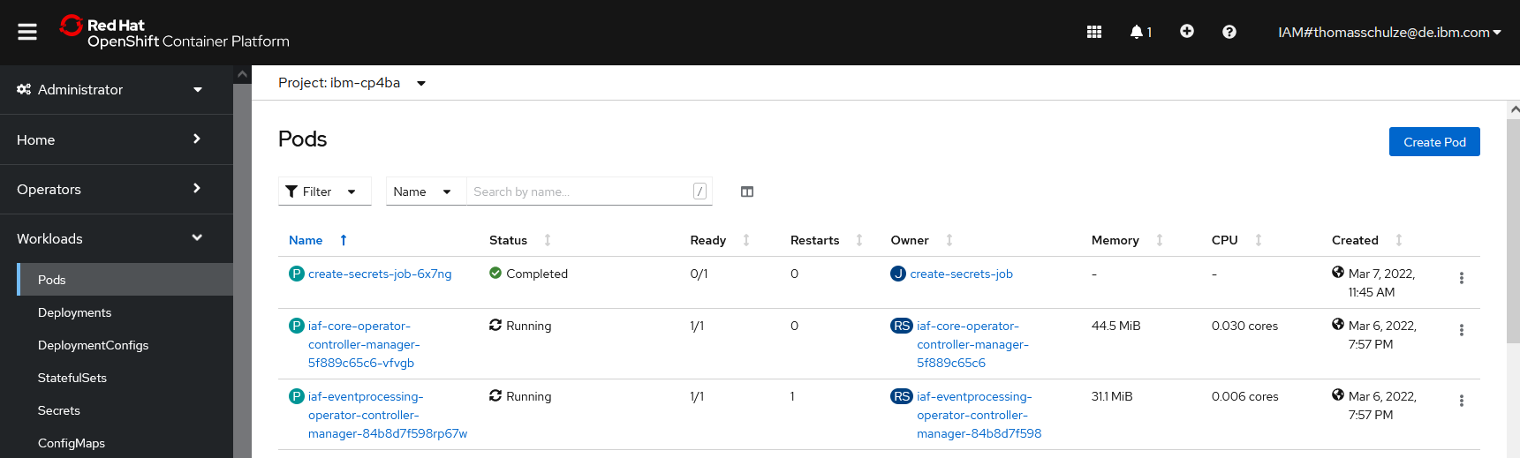
Bring-up (Install & Config) [12 hrs.]
Abstract
Install and configure a Production deployment of IBM Cloud Pak for Business Automation (CP4BA, version 21.0.3 IF005) on an OpenShift cluster on IBM Cloud using the CP4BA rapid deployment scripts
Objective
Learn how to quickly bring-up a Production deployment of IBM CP4BA
Features Exercised
Deploy IBM DB2 Operator, Containers & create needed databases
Install IBM CP4BA Operator
Deploy IBM CP4BA – Production deployment – version 21.0.3 IF005 – Foundation and Content patterns only
Prerequisites:
You must already have an entitlement key / license for CP4BA available
You want to perform this lab? Follow the lab instructions!
Verify that you have an entitlement key / license for CP4BA available (https://myibm.ibm.com/products-services/containerlibrary)
Let us know in Slack channel #cp4ba-tech-jam-bring-up (https://ibm-cloudpak-partners.slack.com/archives/C03LJFJBQ4W) that you are interested in this lab, and you need access to an OpenShift cluster
One of the SWAT team members will help you with that
IBM Software | © 2022 IBM Corporation

Slide 24
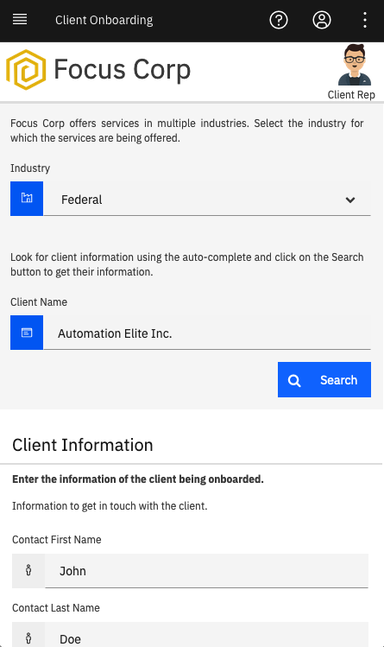



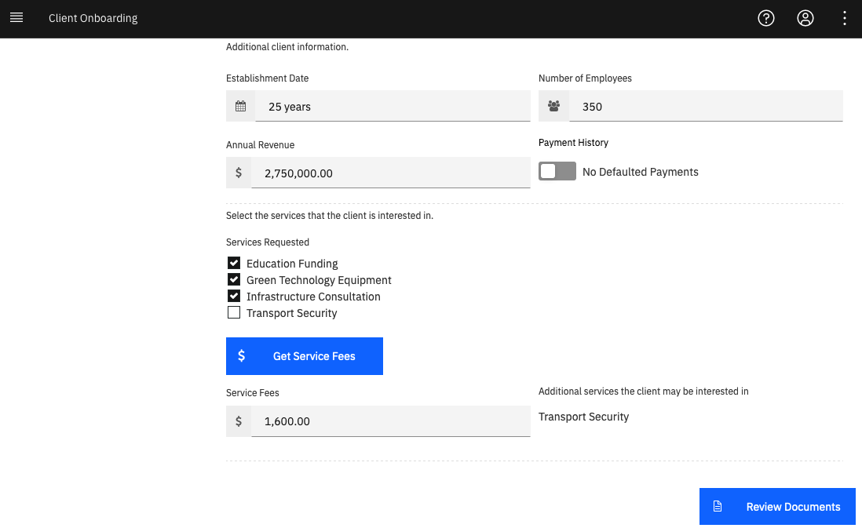
Business Automation Application [2 hrs.]
Abstract
Low-code capability
Create a client onboarding application
Objective
Learn how to create apps using the Application Designer
Leverage services built by developers in other parts of the platform such as Workflow, Decisions & Content.
Features Exercised
Automation Services
Low-code tooling
Basic vs Advanced view mode
Building and creating UIs using views
Responsive applications
IBM Software | © 2022 IBM Corporation

Slide 25
Business Automation Insights (BPC) [1 hour]
Abstract
In this lab exercise you will use Business Performance Center (BPC) as part of Business Automation Insights (BAI) to create a business dashboard that will enable business users to get real time business insights into their client onboarding business.
Objective
The objective of this lab exercise is to enable you to build business dashboards using the data in BAI emitted by CP4BA runtimes such as ADS, Workflow, or Content.
Features Exercised
Dashboard creation and management
Chart creation and configuration
Adding charts to dashboards
Creation and configuration of chart-based business alerts
Organizing charts in dashboards using business goals
IBM Software | © 2022 IBM Corporation

Slide 26
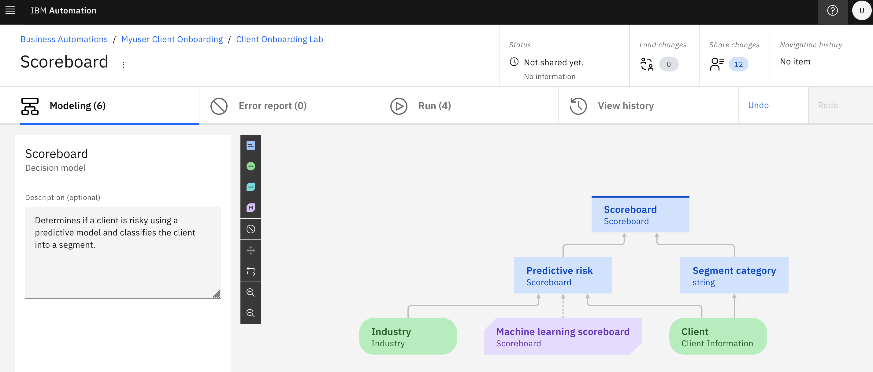
Decisions (Automation Decision Services) [3 hrs.]
Abstract
Create and manage business decisions based on client onboarding solution data
Infuse intelligence by adding a predictive model into a decision service
Connect a decision service to a GitHub repository
Objective
Understand the key concepts of Automation Decision Services
Learn how to model business decisions and validate them
Leverage AI in a decision by creating a predictive model connected to the Machine learning deployment
Learn how to collaborate on your decision services
Features Exercised
Decision automations project
Decision Designer to model, author and validate decisions
Machine learning model invocation from decision model
Deployment in Decision Designer
IBM Software | © 2022 IBM Corporation

Slide 27
FileNet Content Services [6 hrs.]
Abstract
Content Platform Engine (CPE) is configured for storing and maintaining documents for supporting an application
Review Configuration and usage of new features of the products
Objective
Learn about core concepts and features like Document Classes and Properties, Security, Storage Areas
Explore the Graph QL interface and Content Based Retrieval
Features Exercised
Defining Document Properties and Class hierarchy for an application
Configure Security settings through direct and default instance security
Apply Security changes to multiple documents through Bulk Actions
Reassign documents to different storage areas / storage policies
Configure Event Subscriptions
Test integration with Content Search Services
IBM Software | © 2022 IBM Corporation

Slide 28
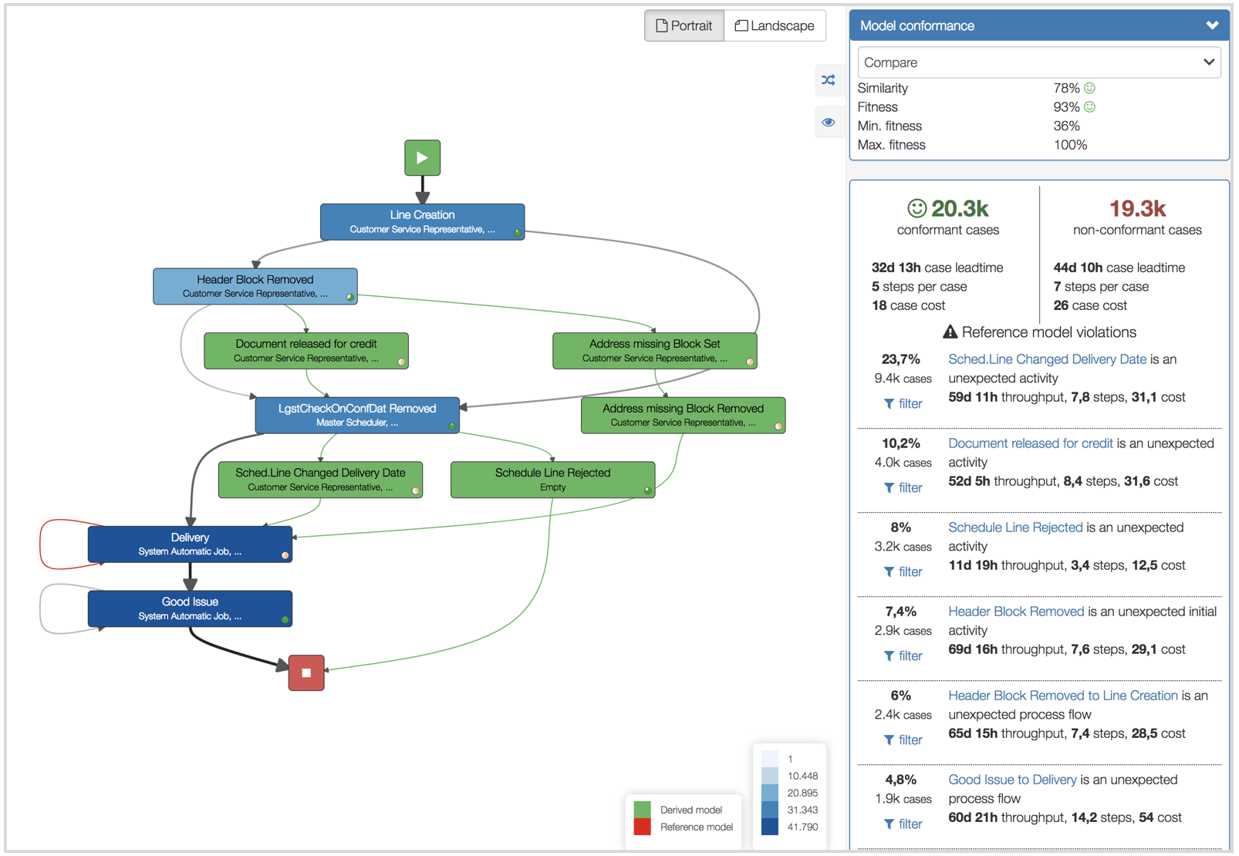
Process Mining [3 hrs.]
Abstract
Explore and master the power of IBM Process Mining and learn how to apply it to real business scenarios
Objective
Master the basics and some of the key advanced Process Mining features
Learn how to use Process Mining to identify business improvement and automation opportunities
Features Exercised
Creation of new project form CSV data sets
Using Process views to discover process bottlenecks, rework, top 5 variants, non-conformant activities
Using Filters to drill down into process data and perform root cause analysis
Using Business Dashboards and Analytics to track KPI violations and identify automation candidates
Use simulations to discovery automation ROI
Learn how use IBM Process Mining to simulate IBM Blueworks Live processes
IBM Software | © 2022 IBM Corporation

Slide 29
Robotic Process Automation [3.5 hrs.]
Abstract
You will use IBM RPA Studio to develop a bot script to automate a Java swing application called Client Management System and a web application called Services Management System. Next you will implement a Workflow Process to invoke this bot to add client information and information about the services they signed up to those two applications. Finally, you will use IBM RPA Studio to develop a chatbot to allow the client to manage some of the client information through themselves.
Objective
Gain basic knowledge of the IBM RPA offering
Learn how to use IBM RPA Studio to develop and debug bot scripts
Learn how to use the Recorder to automate a Java Swing Application
Learn how to automate a web application
Learn how to invoke a bot script from a Workflow process using the IBM RPA REST API
Learn how to use IBM RPA Studio to develop a chatbot and expose it externally through a chat mapping configuration
Features Exercised
IBM RPA Studio
Recorder
IBM RPA REST API
BAW integration with IBM RPA
Chatbot
IBM Software | © 2022 IBM Corporation

Slide 30
Workflow [5 hrs.]
Abstract
Combination of Case and Process capabilities into a unified Workflow offering
Create a client onboarding solution that contains different activities
Objective
Understand the basics of Workflow
Learn how Case and Process integrate together
Build UIs for human services
Leverage services from other capabilities in the platform
Publish services built in Workflow to the platform
Features Exercised
Case & Process integration using toolkit views and JavaScript API
UI creation using Coaches and Client-side human services
Case Builder, Process Designer & Case Client
Automation Services
External Services
IBM Software | © 2022 IBM Corporation

Slide 31

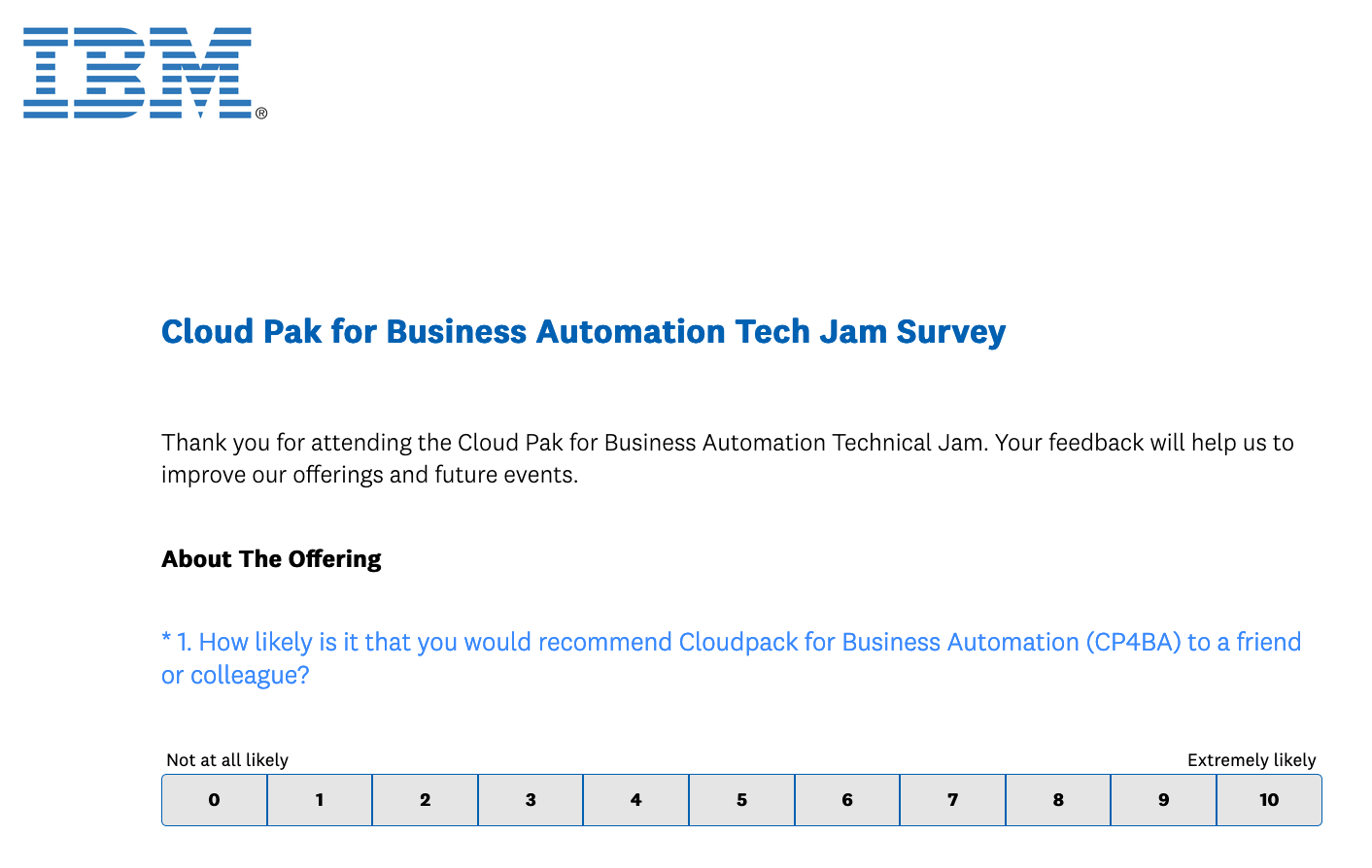
Survey
https://www.surveymonkey.com/r/CP4BATechJam2022
IBM Software | © 2022 IBM Corporation

Slide 32
IBM sign-off
IBM Software | © 2022 IBM Corporation

